Slide 1
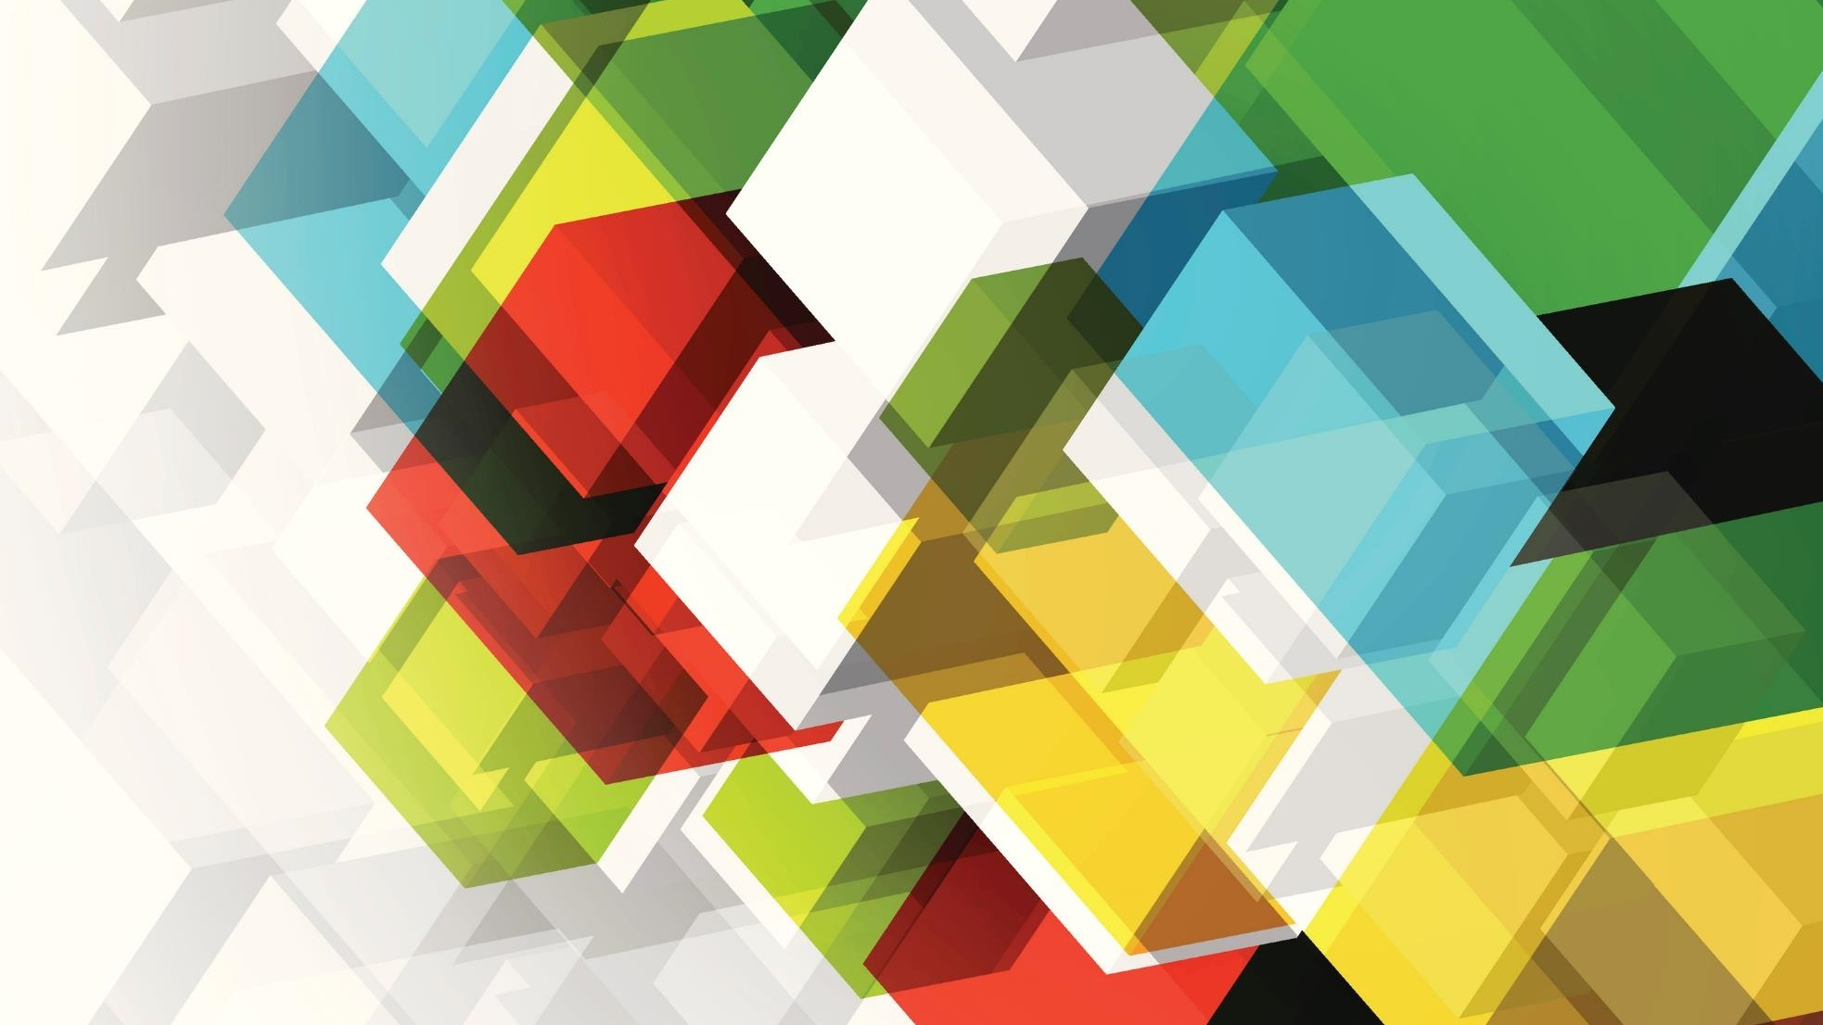
MIGRAINE & STROKE
Mark Weatherall
July 2020

Slide 2
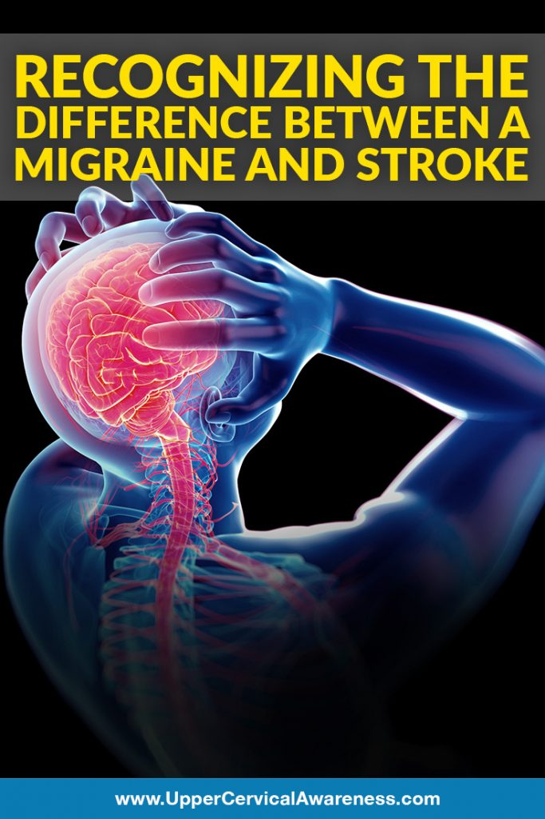
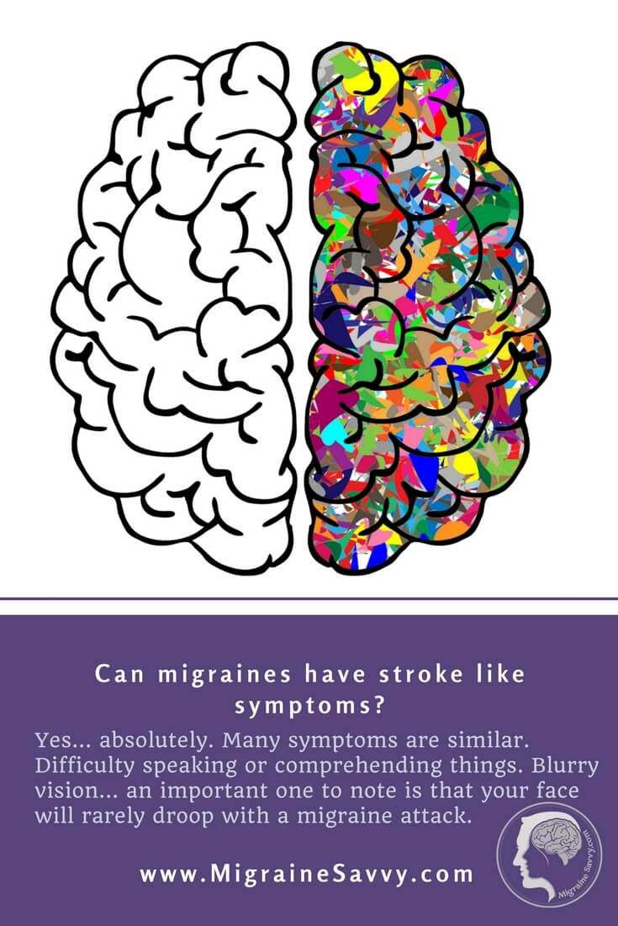

Slide 3
Learning objectives
To UNDERSTAND the evidence THAT migraine INCREASES THE RISK OF CV DISEASE
TO APPRECIATE RISK FACTORS FOR STROKE IN PEOPLE WITH MIGRAINE
TO BE AWARE OF IMAGING CHANGES THAT CAN BE FOUND IN PEOPLE WITH MIGRAINE

Slide 4
Migraine & the risk of ischaemic stroke
Many studies – including 5 meta-analyses – show that MIGRAINE WITH AURA is an independent risk factor for ischaemic stroke
  This association is strongest for WOMEN, WOMEN <45 yrs, WOMEN who use ORAL CONTRACEPTIVES, and WOMEN who SMOKE
  The risk is greater for those with active
  e migraine (i.e. attacks in the last year), and with higher frequency attacks
Whether having MIGRAINE WITHOUT AURA conveys an increase in risk remains uncertain
Migraine is not a significant risk factor for stroke in older people
Migraine is associated with GOOD functional outcome after stroke (MRS 0-1)
Migraine may be associated with haemorrhagic stroke in women <45 yrs (but numbers are very low)
Migraine with aura may be associated with TIA – more studies needed
Migraine is associated with the risk of perioperative stroke

Slide 6
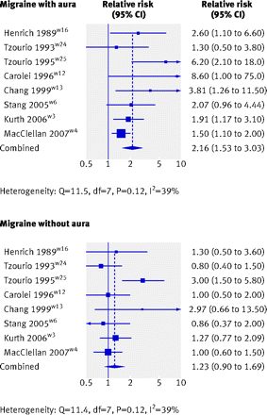
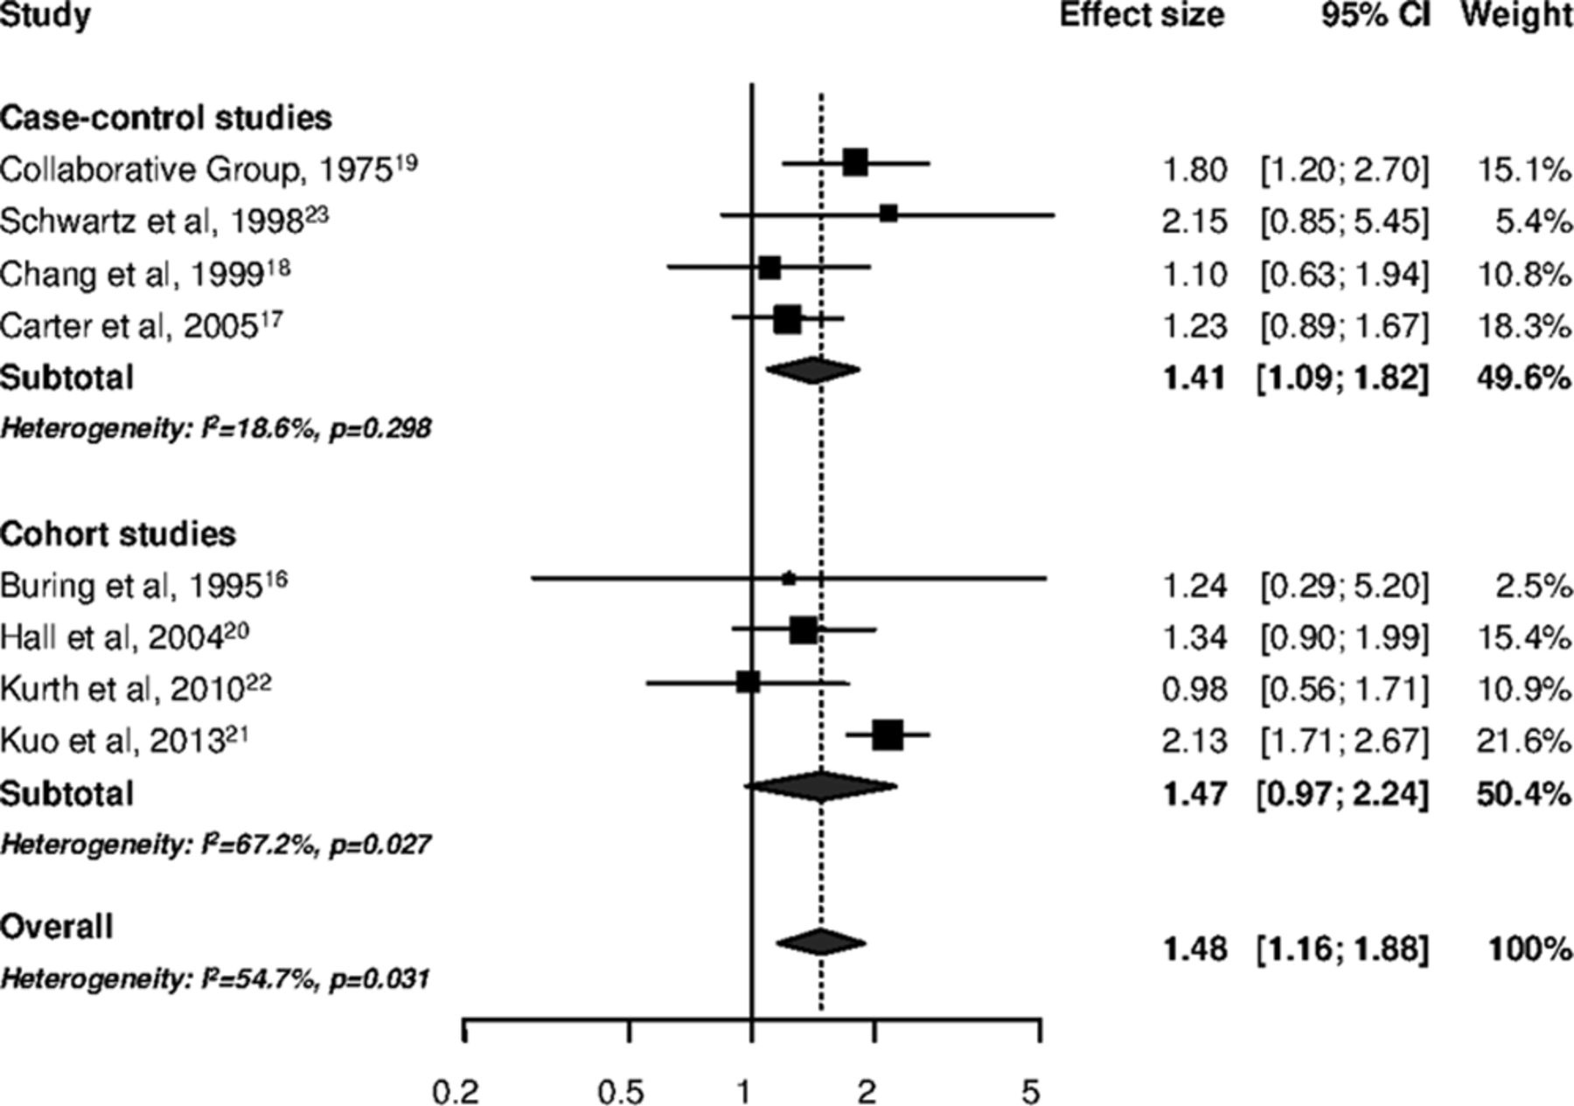

Slide 7
Migraine & cardiovascular disease
Growing evidence for association of migraine (especially migraine with aura) with myocardial infarction, hypertension, atrial fibrillation, and venous thromboembolism
  migraine increases the 10 year risk of coronary heart disease based on the Framingham Risk Score
Annual additional cardiovascular risk from migraine is low, but cumulative risk over many years is sufficient for it to have been included in the QRISK3 algorithm
But… the coronary & carotid arteries of individuals with active migraine are less severely affected by atherosclerosis than individuals without migraine
  this suggests a non-atherosclerotic cause for migaine-associated CV risk
Co-morbidities (HT, DM, dyslipidaemia) in migraine patients should be treated proactively
Oral contraceptives should not be used in women with MA & comorbid RF or thrombophilia

Slide 8
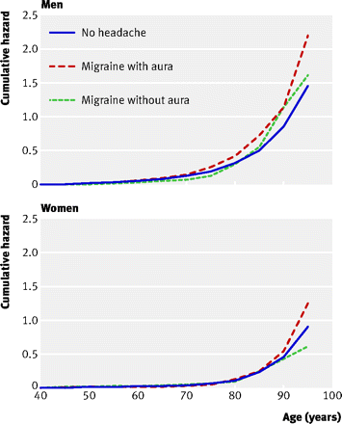
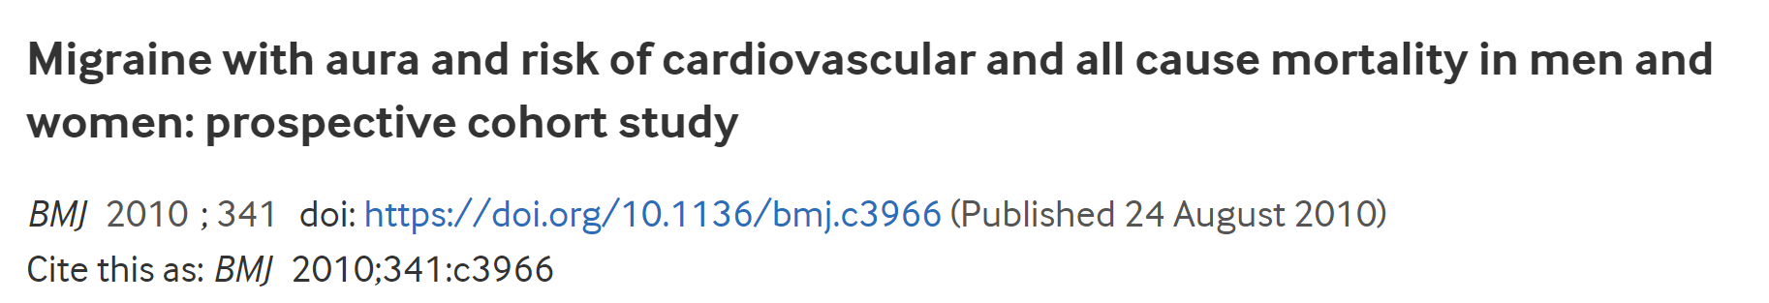

Slide 9
Migraine drugs & the risk of stroke
Ergot-derived drugs (ergotamine/DHE) do convey an increased risk of serious vascular events due to vasoconstriction
There is no evidence of cardiovascular safety issues for triptans
  Main effect of triptans is to reverse CGRP-induced vasodilation
  Vasoconstriction of coronary & carotid arteries in vivo is probably no more than 5% - unlikely to be clinically relevant unless severe underlying arterial disease
Novel acute drugs (CGRP antagonists, lasmitidan) have been shown not to affect vascular tone at all & may become options for acute treatment of migraine in people with known CV disease
CGRP monoclonal antibodies – the first of which (Ajovy; fremanezumab) has just been approved for use on the NHS – have not been shown to have significant effects on vascular risk
  Single case study of thalamic stroke following administration of erenumab
  Theoretical concerns about worsening of outcomes after ischaemic events
There is no evidence that preventing migraine attacks reduces the likelihood of stroke

Slide 10
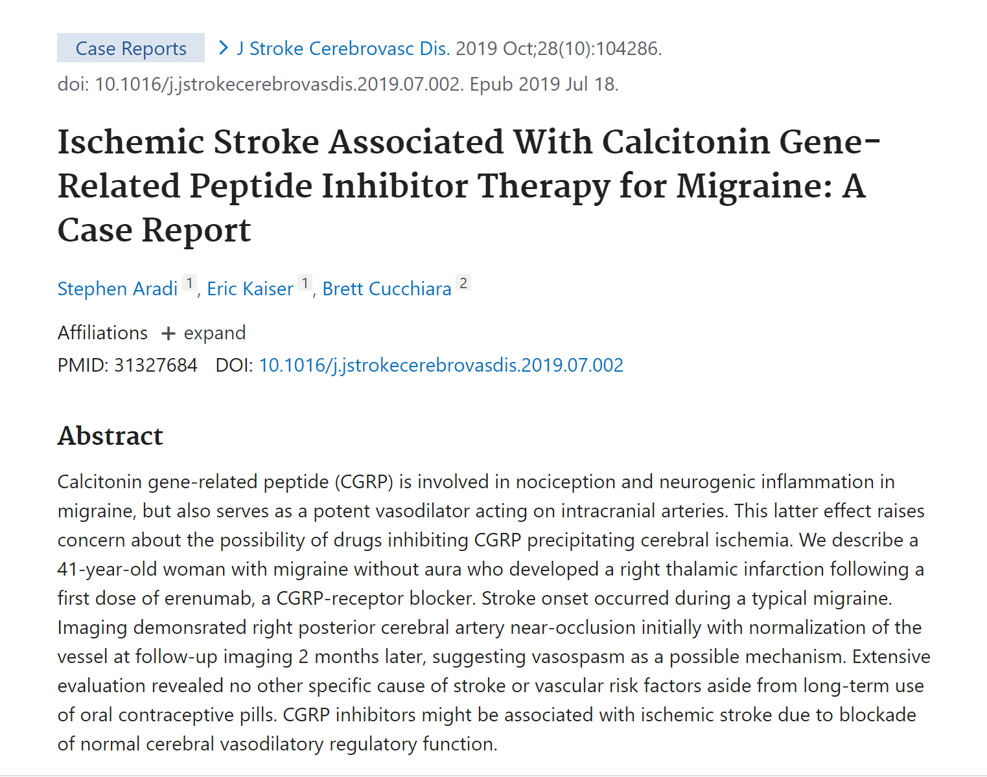

Slide 11
Migraine & neuroimaging
Cortical perfusion changes seen in migraine with aura are very different in timing (moderate increase in time to peak) & distribution (crossing different vascular territories) to those seen in ischaemic stroke (sudden hypoperfusion in delineated territory of affected vessel/s)
People with migraine may have higher parenchymal blood flow in inter-ictal period (especially basilar artery)
Clinically silent brain lesions often seen on MRI imaging of patients with migraine
  Non-specific, aetiology & clinical significance remain uncertain
  Not modified by traditional CV risk factors
  Includes white matter hyperintensities & silent infarct-like lesions (particularly posterior circulation/cerebellum)

Slide 12
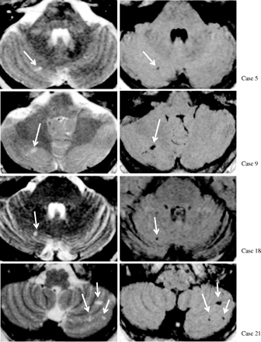
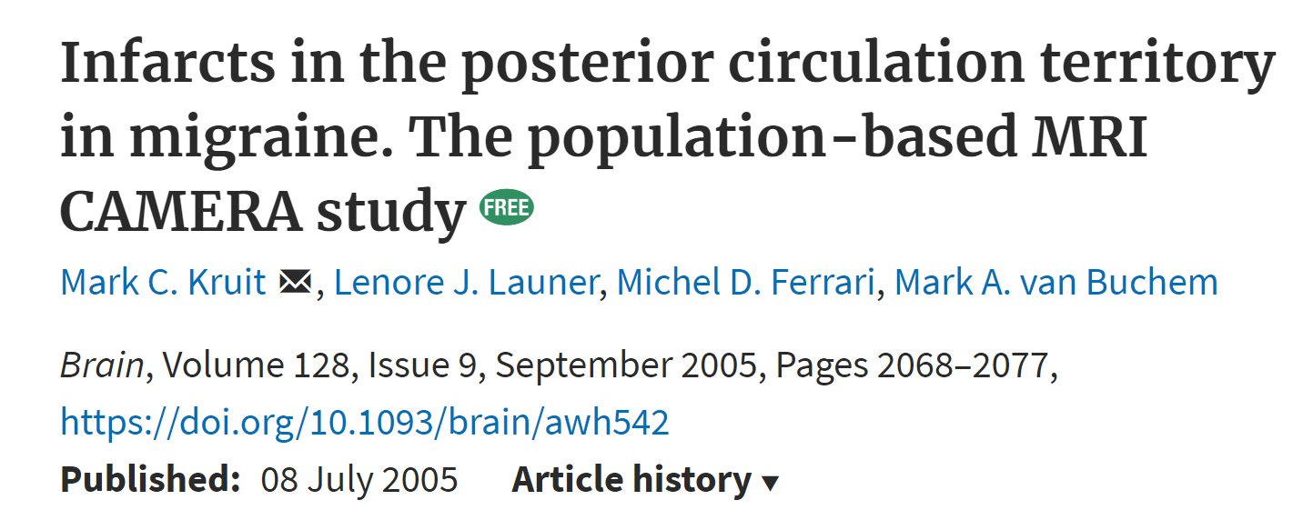

Slide 16
Migraine & stroke in women
Migraine is more common in women (3:1) and in mid-life. Approximately 30% of women will experience migraine in reproductive years
Overall risk of oral contraceptives is low, but caution should be exercised, especially in women with aura, women >35 yr, women who smoke, or who have known stroke risk factors
  Assessment for genetic/acquired coagulopathy might be appropriate
Development of new or unusual migraine symptoms following OC use requires prompt evulation and possible cessation of treatment
There is no definitive data on whether migraine modifies the risks associated with HRT
Active migraine in pregnancy should be regarded as a risk factor for vascular complications, including ischaemic stroke
  High-risk obstetric monitoring may be indicated

Slide 17
Mechanisms linking migraine to stroke
Cortical spreading depression is an intense depolarising wave of neuronal and glial membranes that spreads slowly across the cortex
  Accompanied by brief hyperperfusion that lasts 1-2 minutes, then depolarization and hypoperfusion that can last 1-2 hours (~20-30% reduction in CBF)
CSD can be triggered experimentally by electrical or mechanical stimulation, hypoxia, ischaemia, embolism (air bubbles, cholesterol, crystals, endothelin)
Arterial or endothelial dysfunction is postulated as a potential mechanistic link between migraine and stroke
  Studies show conflicting results – MA may be associated with alterations in circulating coagulation factors
Shared genetic factors seen in GWAS
  Rare disorders charaterised by both migraine and stroke include CADASIL, MELAS, RVCL

Slide 18
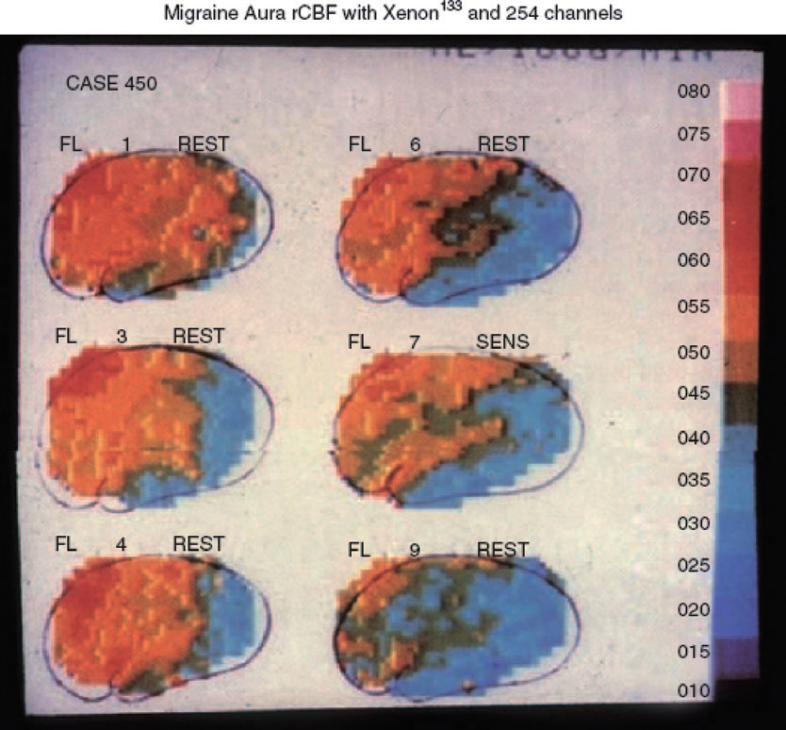
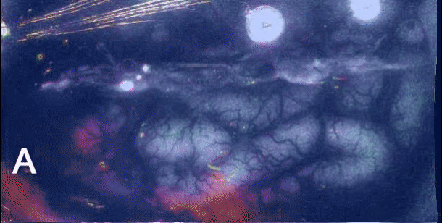
Cortical spreading depression seen using intrinsic optical signal imaging in gyrencephalic brain. Speed 50x. From Santos E et al. Neuroimage 2014.

Slide 19
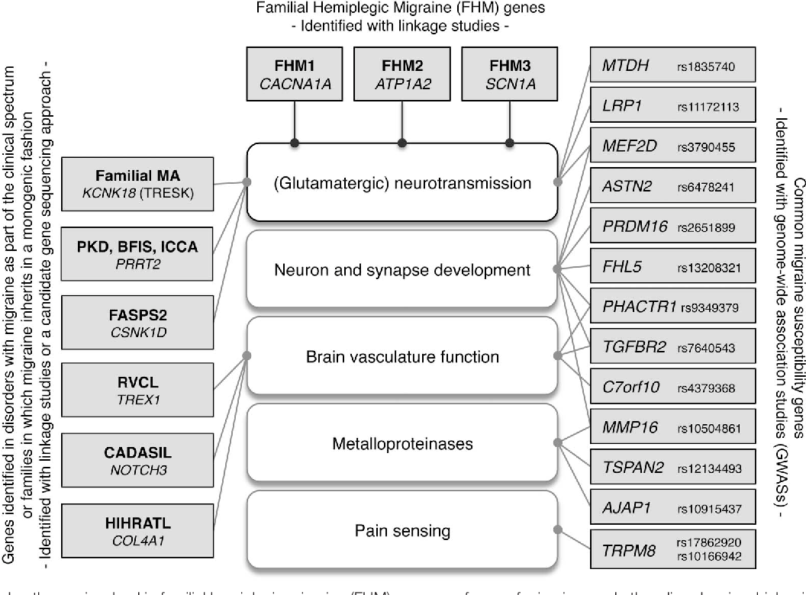

Slide 20
Mechanisms linking migraine to stroke
Migrainous infarction is rare (<0.5% of all ischaemic strokes); exact pathophysiology remains unknown
  Presumed due to critical ischaemia following CSD
  Ischaemic cerebral events can trigger CSD & aura-like events
Patent foramen ovale
  Is more common in people with migraine than would be expected by chance
  Does this act as a risk factor for both migraine with aura (CSD triggered by paradoxical emboli) and stroke?
  Spontaneous R>L shunts have been associated with migraine persistence into old age, but not stroke
Cervical arterial dissection is associated with both migraine and stroke
  May trigger aura by hypoperfusion or by release of substances from damaged endothelium that trigger aura
  But association is stronger for migraine without aura, men, and younger age groups
Atrial fibrillation is associated with migraine with aura, probably in women & men >60 yr

Slide 21
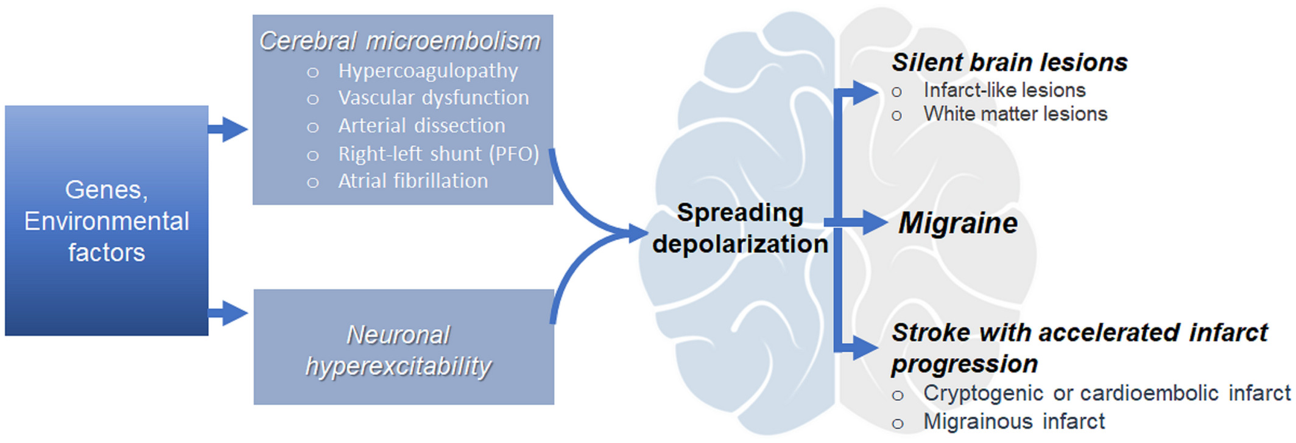
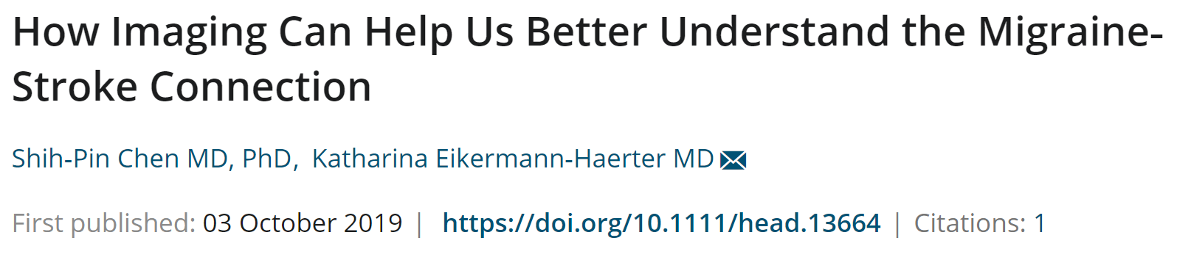

Slide 22
Summary
Migraine (particularly with aura) is associated with increased risk of ischaemic stroke, haemorrhagic stroke & cardiovascular disease
There are currently no reliable clinical, serum or imaging biomarkers that predict which individuals with migraine are at high risk of ischaemic stroke
No clinical studies currently support any specific interventions for the primary prevention of stoke in people with migraine
Acute treatment and secondary prevention in patients with stroke or TIA do not differ in people with and without a history of migraine
Future studies should address whether effective preventive treatment of migraine (especially but not solely with CGRP monoclonal antibodies) decreases the risk of ischaemic stroke
Further studies of patients with migraine and ischaemic stroke may identify causal genetic factors

